Slide 1
Computer Networks and Operating Systems Project
Designing computer network of Solomons Building.
Bogza Gabriel
Manolache Roxana
Group 5311

Slide 2
Beneficiary Card

Slide 3
Solomons Building
Activity profile: renting and leasing of own of rented properties
Renters activity profile: Software development
Advocacy
Medical recovery, labor medicine (Arcadia)
Number of employees in the building: Approximate of 260
Development plans: In the next 5 years we want to maintain the best network infrastructure for our renters. Also we will develop a platform in which every employee can supervise their desk from phone and also a security system through which every employee has access in the building by access cards. Something else that we have in plan is to rent the entire building and reach the maximum number of people in the building (300).

Slide 4
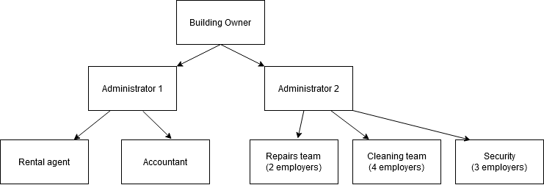
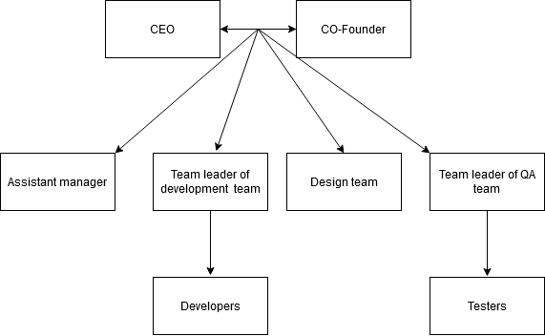
Organizational structure: Employers of the building
Organizational structure of an IT Company:

Slide 5
2.Building Structure

Slide 6
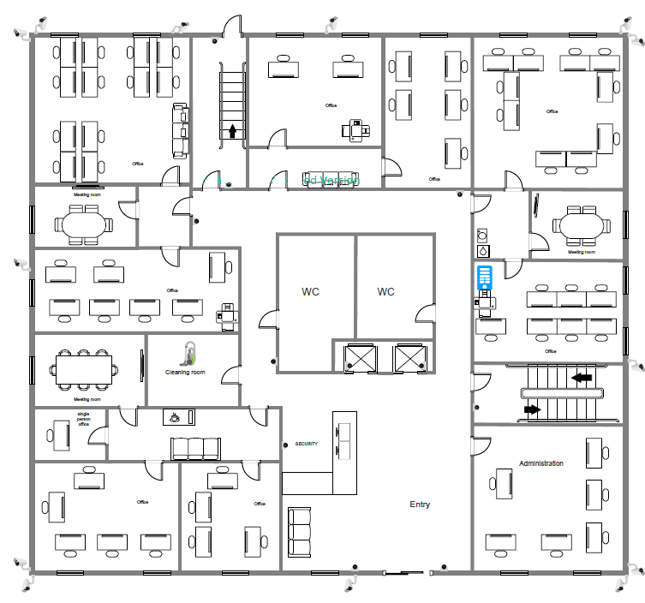
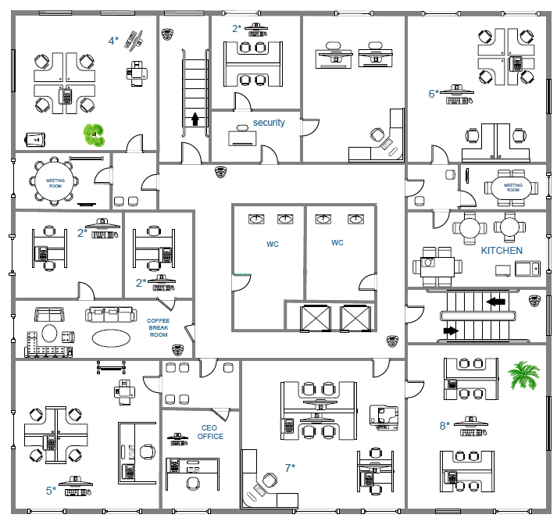
Ground Floor
First floor

Slide 7
3. Subnetting

Slide 8
IP Address Analysis
Network Address class B: 168.177.0.0 /21
Subnetwork MASK: 255.255.248.0
In the future we estimate a number of 16 subnetworks with approximately 100 hosts/ subnetwork
5 Subnetwork bits => 2^5=32 subnetworks
11 host bits, 2^11-2=2046 hosts

Slide 9
Subnetwork | Subnet (binary) | IP address of subnetwork | IP address of subnetwork (binary) | Host addresses range | Broadcast Address
#0 | 00000 | 168.177.0.0 | 10101000‬.10110001‬. 0.0 | 168.177.0.1 - 168.177.7.254 | 168.177.7.255
#1 | 00001 | 168.177.8.0 | 10101000‬.10110001‬. 00001000.0 | 168.177.8.1 -168.177.15.254 | 168.177.15.255
#2 | 00010 | 168.177.16.0 | 10101000‬.10110001‬. 00010000‬.0 | 168.177.16.1 - 168.177.23.254 | 168.177.23.255
#3 | 00011 | 168.177.24.0 | 10101000‬.10110001‬. 00011000‬.0 | 168.177.24.1 - 168.177.31.254 | 168.177.31.255
#4 | 00100 | 168.177.32.0 | 10101000‬.10110001‬. 00100000‬‬.0 | 168.177.32.1 - 168.177.39.254 | 168.177.39.255
#5 | 00101 | 168.177.40.0 | 10101000‬.10110001‬. 00101000‬‬‬.0 | 168.177.40.1 -168.177.47.254 | 168.177.47.255
#6 | 00110 | 168.177.48.0 | 10101000‬.10110001‬. 00110000‬‬.0 | 168.177.48.1 - 168.177.55.254 | 168.177.55.255
#7 | 00111 | 168.177.56.0 | 10101000‬.10110001‬. 00111000‬‬.0 | 168.177.56.1 - 168.177.63.254 | 168.177.63.255

Slide 10
#8 | 01000 | 168.177.64.0 | 10101000‬.10110001‬. 01000000‬‬.0 | 168.177.64.1 - 168.177.71.254 | 168.177.71.255
#9 | 01001 | 168.177.72.0 | 10101000‬.10110001‬. 01001000‬‬.0 | 168.177.72.1 -168.177.79.254 | 168.177.79.255
#10 | 01010 | 168.177.80.0 | 10101000‬.10110001‬. 01010000‬‬.0 | 168.177.80.1 - 168.177.87.254 | 168.177.87.255
#11 | 01011 | 168.177.88.0 | 10101000‬.10110001‬. 01011000‬‬.0 | 168.177.88.1 - 168.177.95.254 | 168.177.95.255
#12 | 01100 | 168.177.96.0 | 10101000‬.10110001‬. 01100000‬‬.0 | 168.177.96.1 - 168.177.103.254 | 168.177.103.255
#13 | 01101 | 168.177.104.0 | 10101000‬.10110001‬. 01101000‬‬.0 | 168.177.104.1 -168.177.111.126 | 168.177.111.255
#14 | 01110 | 168.177.112.0 | 10101000‬.10110001‬. 01110000‬‬.0 | 168.177.112.1 - 168.177.119.190 | 168.177.119.255
#15 | 01111 | 168.177.120.0 | 10101000‬.10110001‬. 01111000‬‬.0 | 168.177.120.1 - 168.177.127.254 | 168.177.127.255
#16 | 10000 | 168.177.128.0 | 10101000‬.10110001‬. 10000000‬‬.0 | 168.177.128.1 - 168.177.135.254 | 168.177.135.255

Slide 11
4.Network Simulation

Slide 12
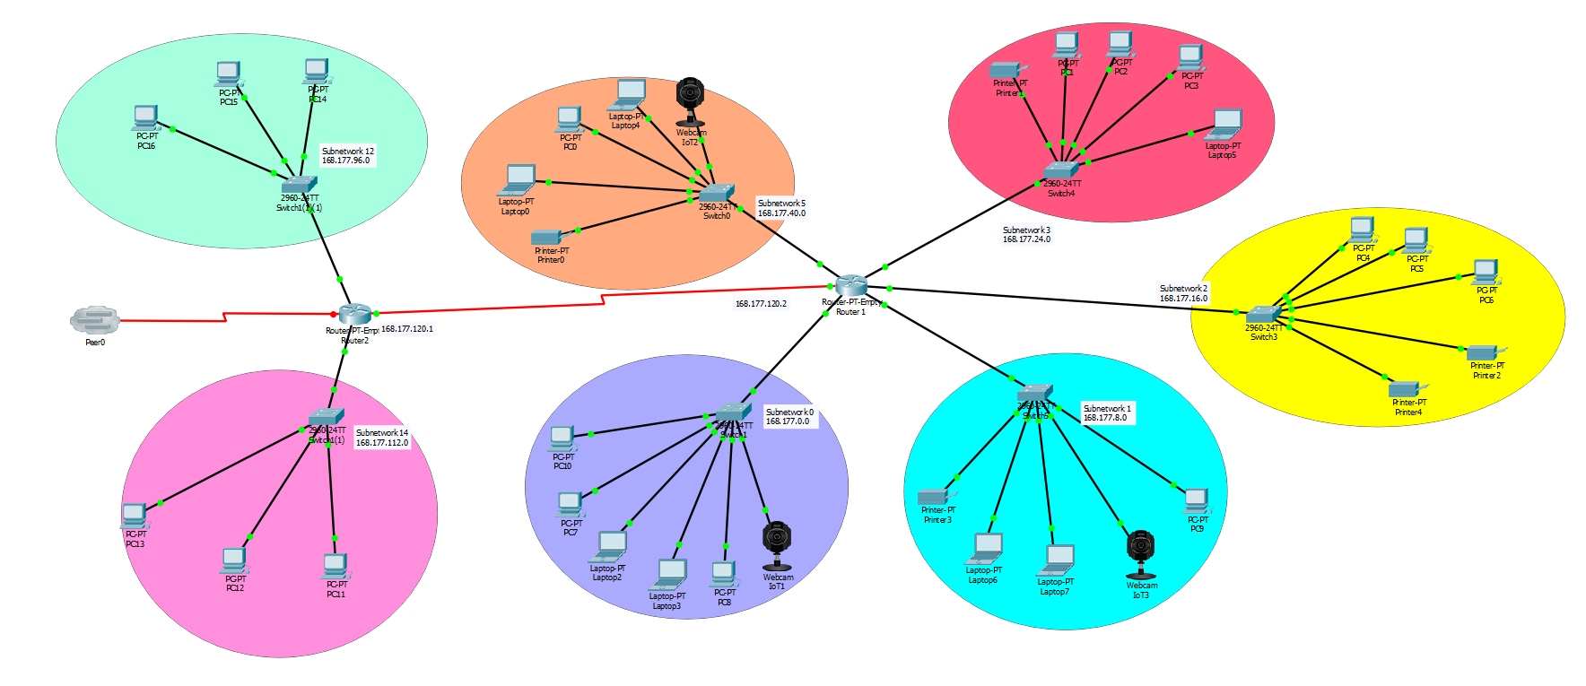

Slide 13


Slide 14
5.Projecting Costs

Slide 15
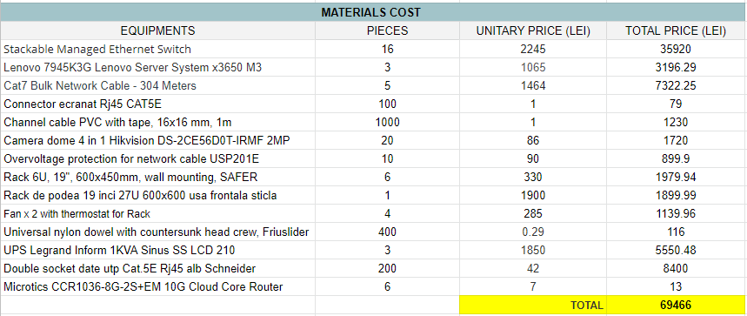

Slide 16
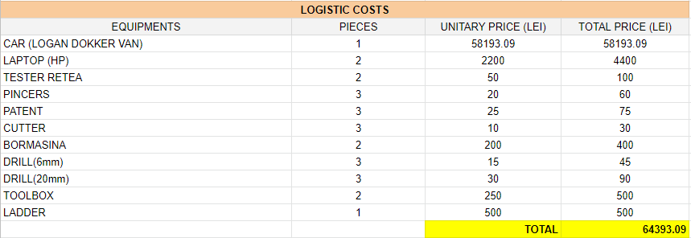

Slide 17
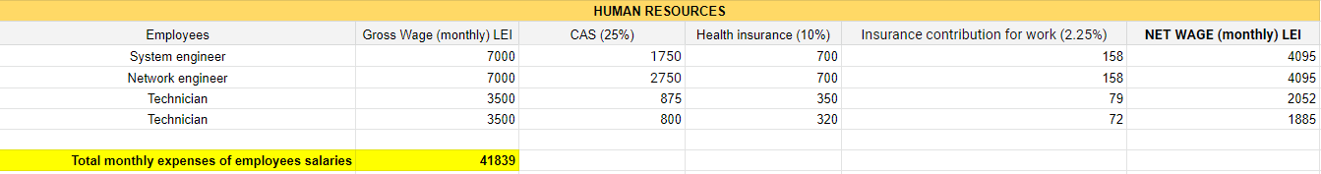
Project realization time: 2 weeks
For the project will work: 2 engineers and 2 technicians
Salary expenses (LEI): 20919.5

Slide 18
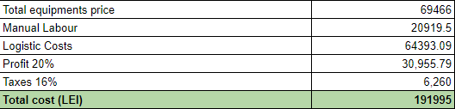
Total Costs

